Slide 1
Case Study 4
HR Analytics
By: Enbo Tian, Sirshendu Ganguly, Dang Tran

Slide 2
Motivation and Background

Slide 3
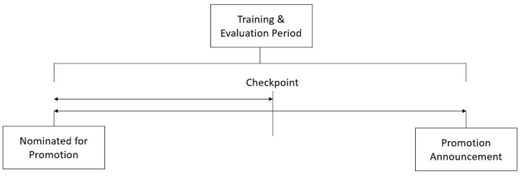
Motivation and Background
MNCs spend a lot of money to determine which employee deserves a promotion.
Current process entails:
Identifying a set of potential promotee.
Have them go through a training and evaluation program.
Appraise the employees and select those worthy of promotion.
Disadvantage: The final promotions are announced too late and can leads to delay in transition.
Figure: Current Promotion Process

Slide 4

Motivation and Background
Solution:
Nowadays every MNC generates a lot of data.
As a group of data scientists we propose an ML model that can be used to predict who is worthy of promotion at given checkpoint before the final evaluation period.
Figure: Data Science Competition

Slide 5
Mathematical Model

Slide 6
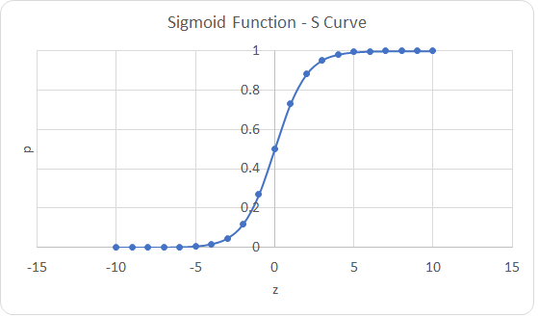

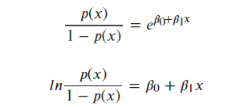
Mathematical Model: Logistic Regression
Logistic regression equation:
Implementation:
Figure: Sigmoid Function

Slide 7
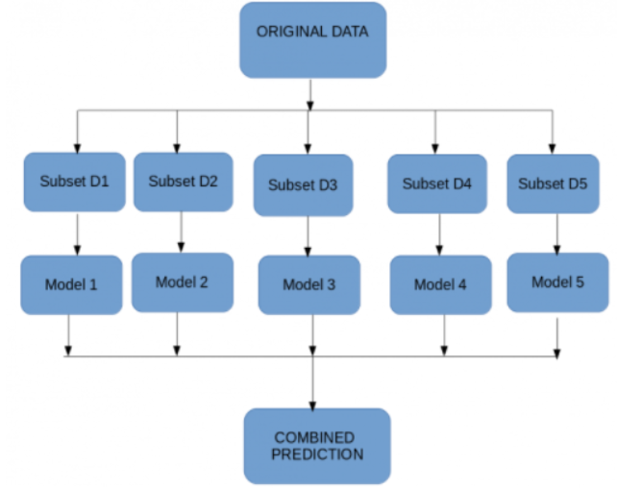
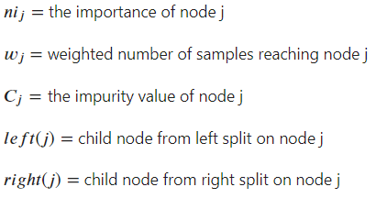
Mathematical Model: Random Forest/1
For each decision tree, Scikit-learn calculates a nodes importance using Gini Importance, assuming only two child nodes (binary tree):
Figure: Working of Random Forest

Slide 8

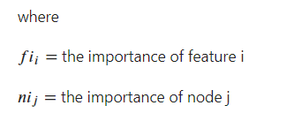



Mathematical Model: Random Forest/2
The importance of each feature on a decision tree is then calculated as:
These can then be normalized to a value between 0 and 1 by dividing by the sum of all feature importance values:
Random Forest:

Slide 9


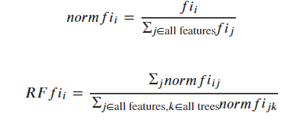
Mathematical Model: Random Forest/3
Then
and

Slide 10


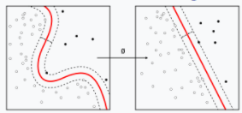

Mathematical Model: Gradient Boosting/1
The goal is to find some function that best approximates the output variable y from the values of input variables x.
Gradient Boosting method:

Slide 11
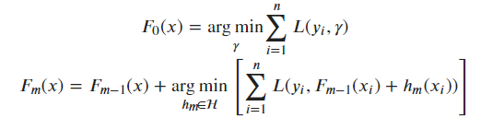
Mathematical Model: Gradient Boosting/2
Starting with a model, consisting of a constant function , and incrementally expands it in a greedy fashion:

Slide 12
Data Source
We would like thank Analytics Vidhya for hosting the dataset for free here: https://datahack.analyticsvidhya.com/contest/wns-analytics-hackathon-2018-1/#ProblemStatement

Slide 13
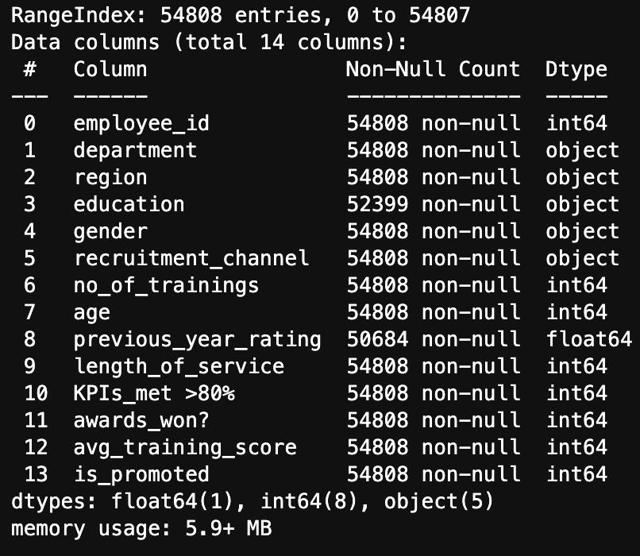
Data Source
employee_id: Unique ID for employee
department: Department of employee
region: Region of employment (unordered)
education: Education Level
gender: Gender of Employee
recruitment_channel: Channel of recruitment for employee
no_of_trainings: no of other trainings completed in previous year on soft skills, technical skills etc.
age: Age of Employee
previous_year_rating: Employee Rating for the previous year
length_of_service: Length of service in years
KPIs_met >80%: if Percent of KPIs(Key performance Indicators) >80% then 1 else 0
awards_won?: if awards won during previous year then 1 else 0
avg_training_score: Average score in current training evaluations
is_promoted: (Target) Recommended for promotion
Figure: The columns of the dataframe ‘employee’

Slide 14
Methodology and Results

Slide 15
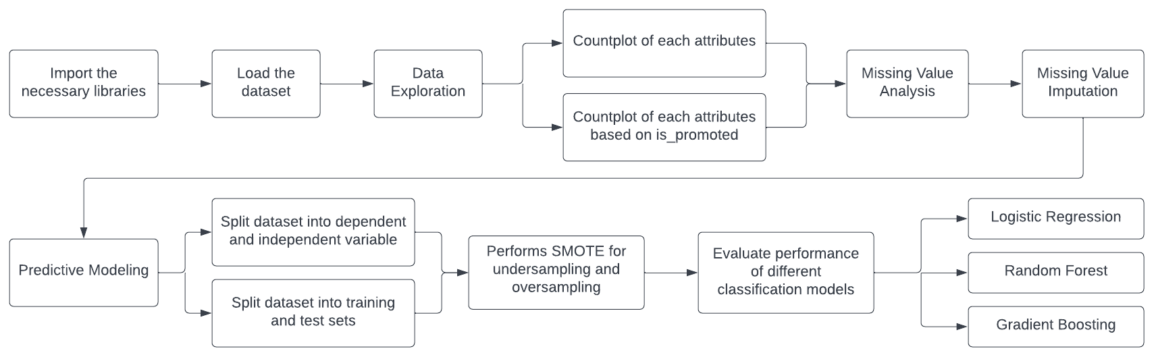
Workflow
Figure: Flow chart of the methodology

Slide 16
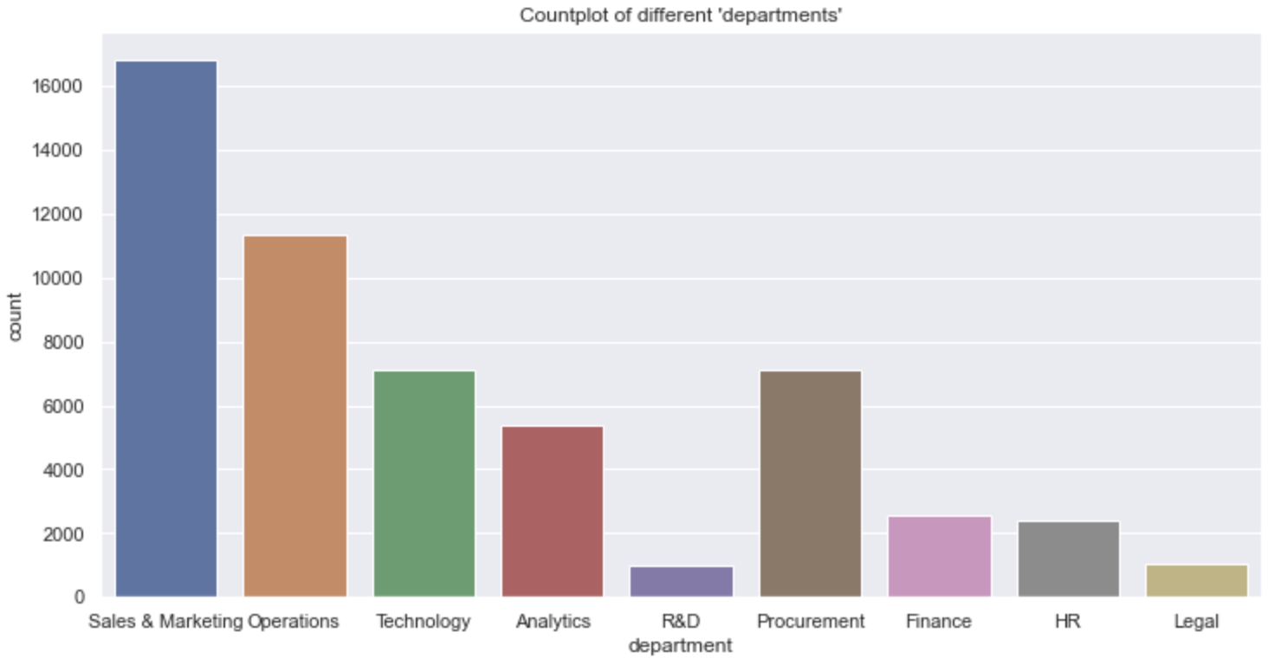
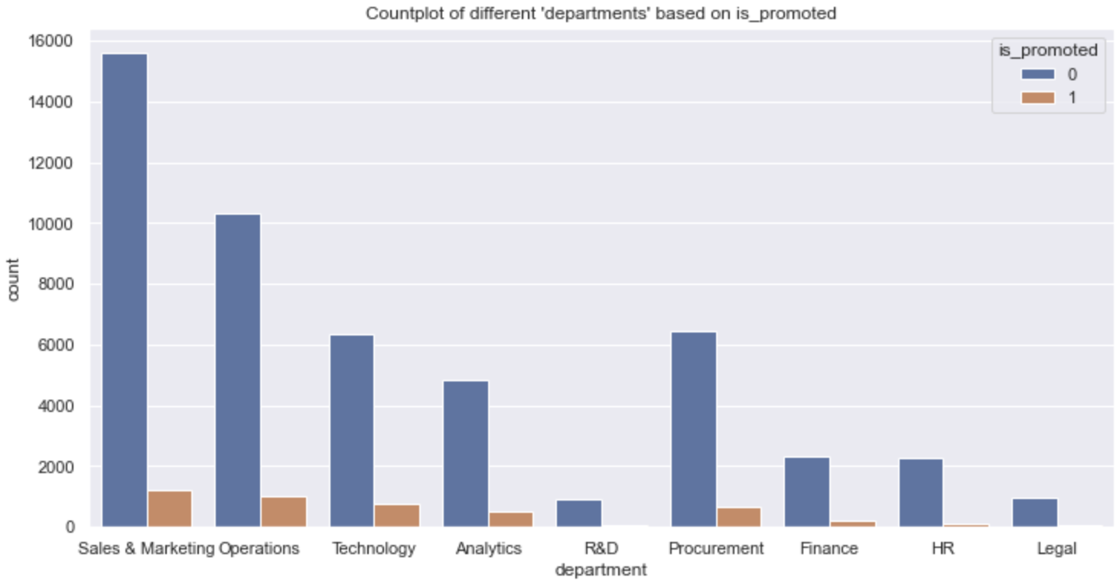
Data exploration:
The bar graph depicting the different types of ‘department’
Figures: Bar graph of types of ‘department’

Slide 17
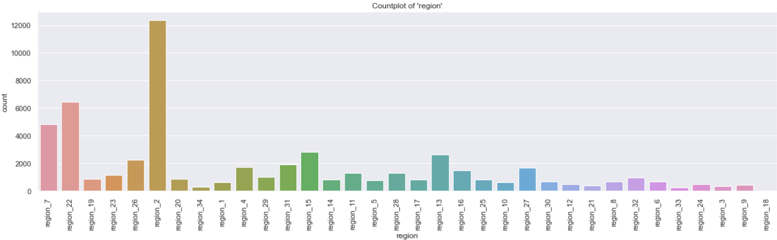
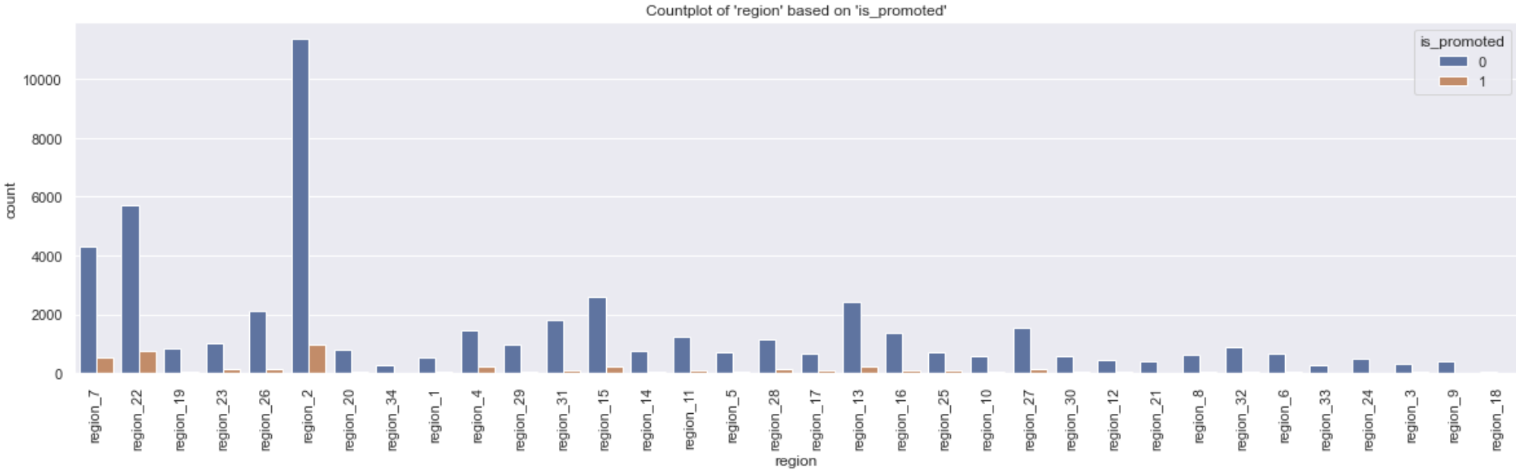
Data exploration:
The bar graph depicting the different types of ‘region’
Figures: Bar graph of types of region

Slide 18
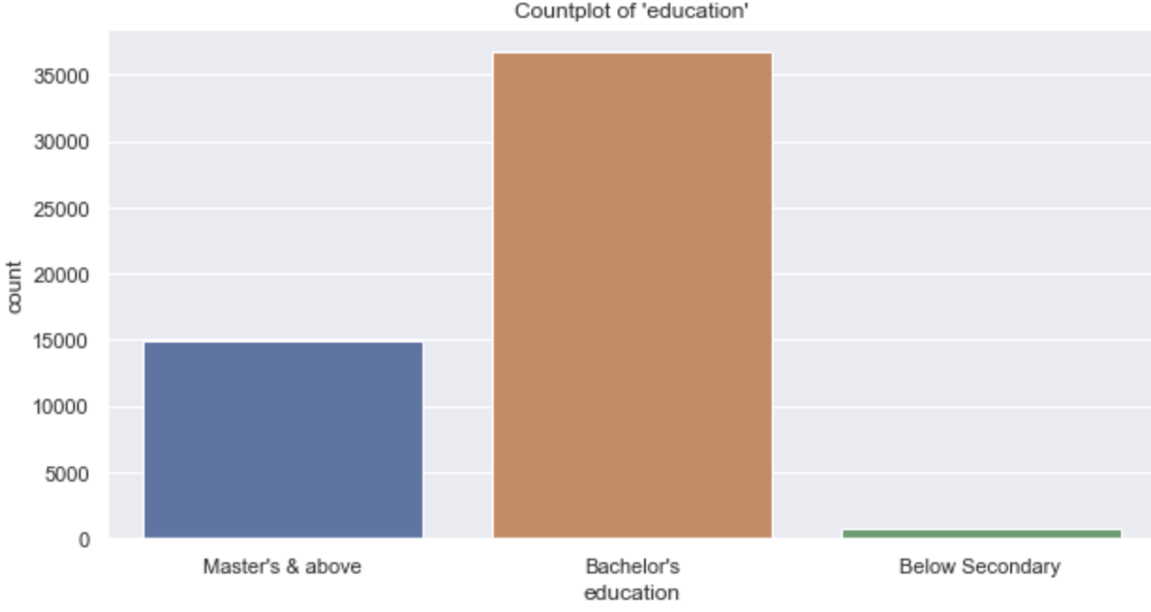
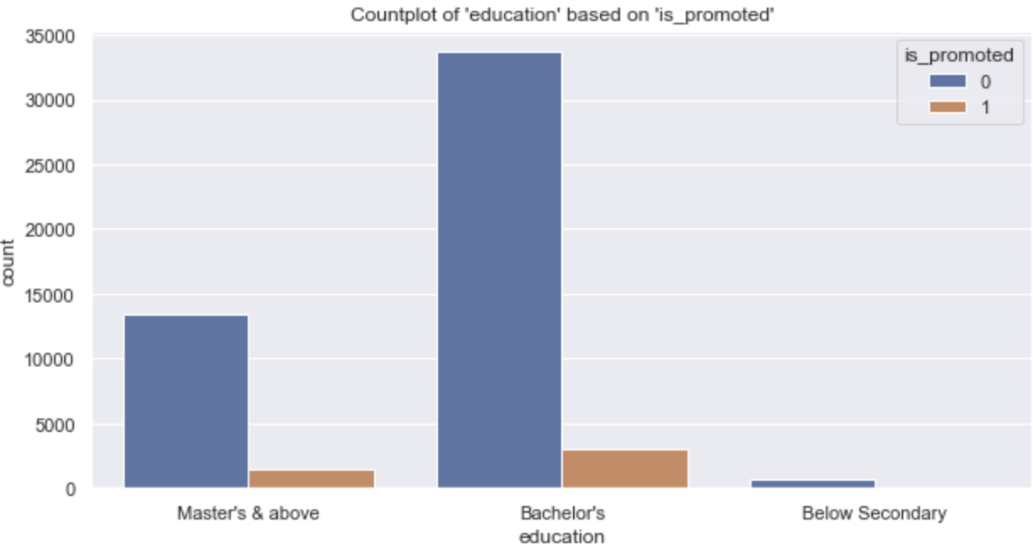
Data exploration:
The bar graph depicting the different types of ‘education’
Figures: Bar graph of types of ‘education’

Slide 19
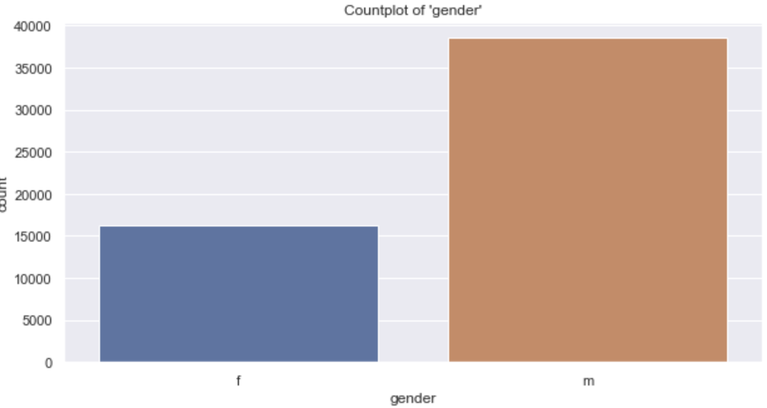
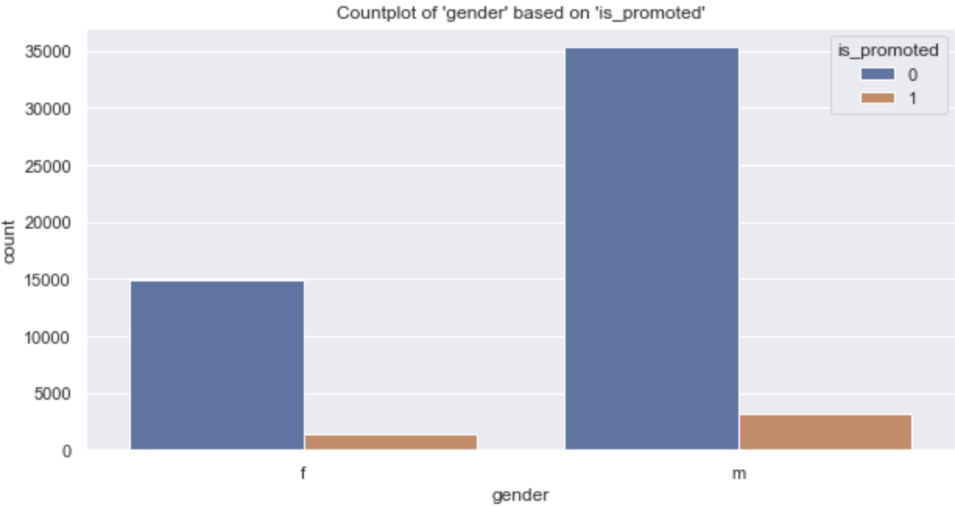
Data exploration:
The bar graph depicting the different types of ‘gender’
Figures: Bar graph of types of ‘gender’

Slide 20
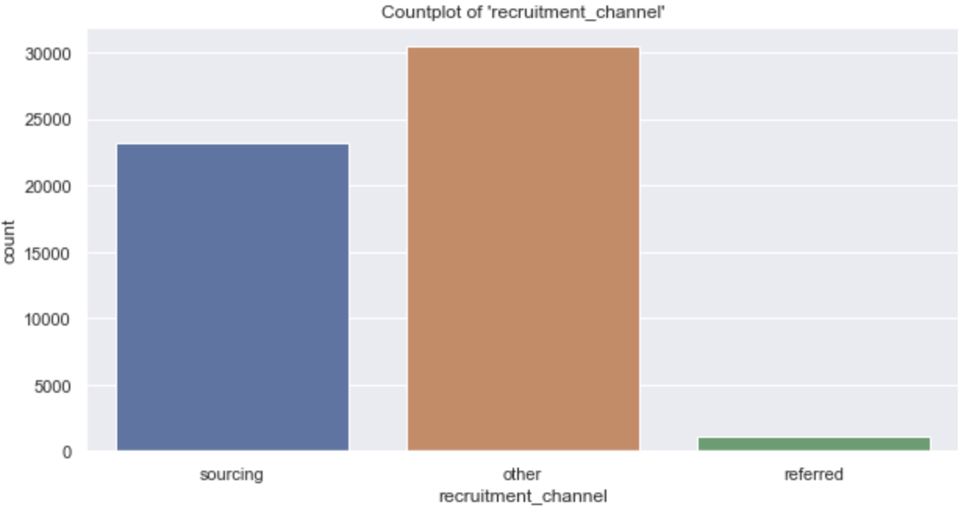
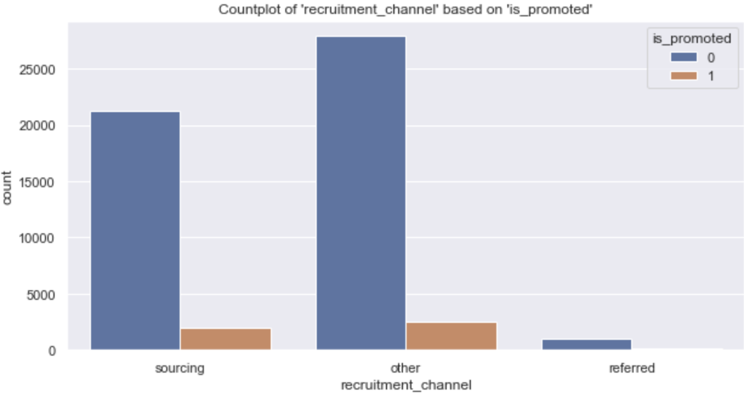
Data exploration:
The bar graph depicting the different types of ‘recruitment_channel’
Figures: Bar graph of types of ‘recruitment_channel’

Slide 21
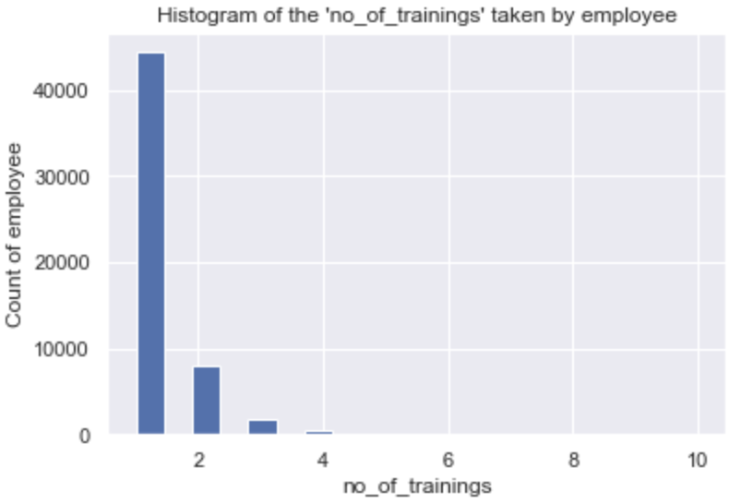
Data exploration:
The histogram depicting the distribution of the employee’s no of training
Figure: Histogram of the employee’s no of training

Slide 22
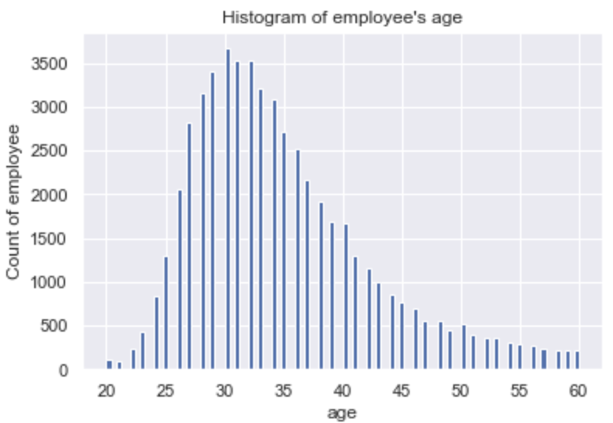
Data exploration:
The histogram depicting the distribution of the employee’s age
Figure: Histogram of the employee’s age

Slide 23
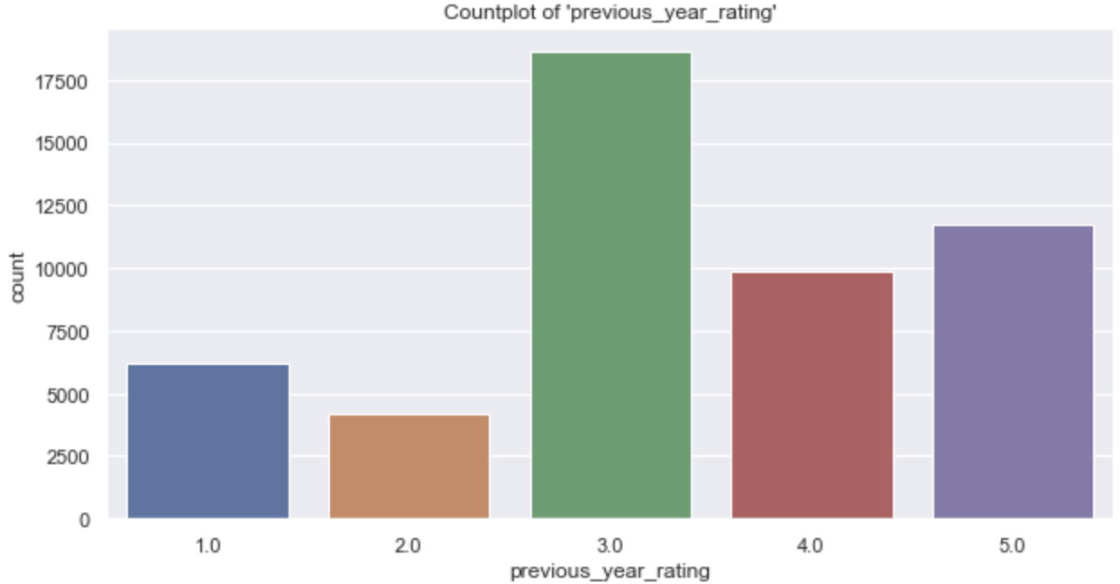
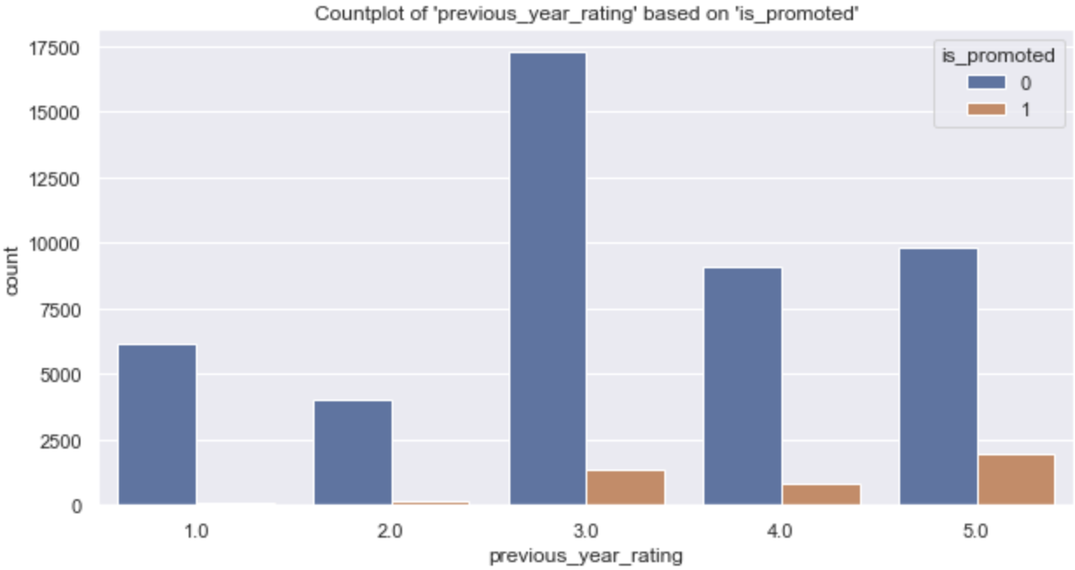
Data exploration:
The bar graph depicting the different types of ‘previous_year_rating’
Figures: Bar graph of types of ‘previous_year_rating’

Slide 24
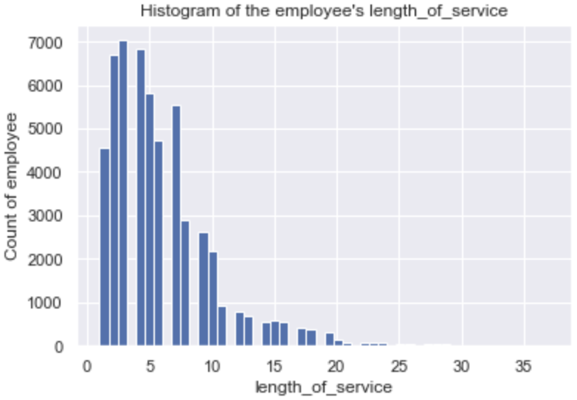
Data exploration:
The histogram depicting the distribution of the employee’s length of service
Figure: Histogram of the employee’s length of service

Slide 25
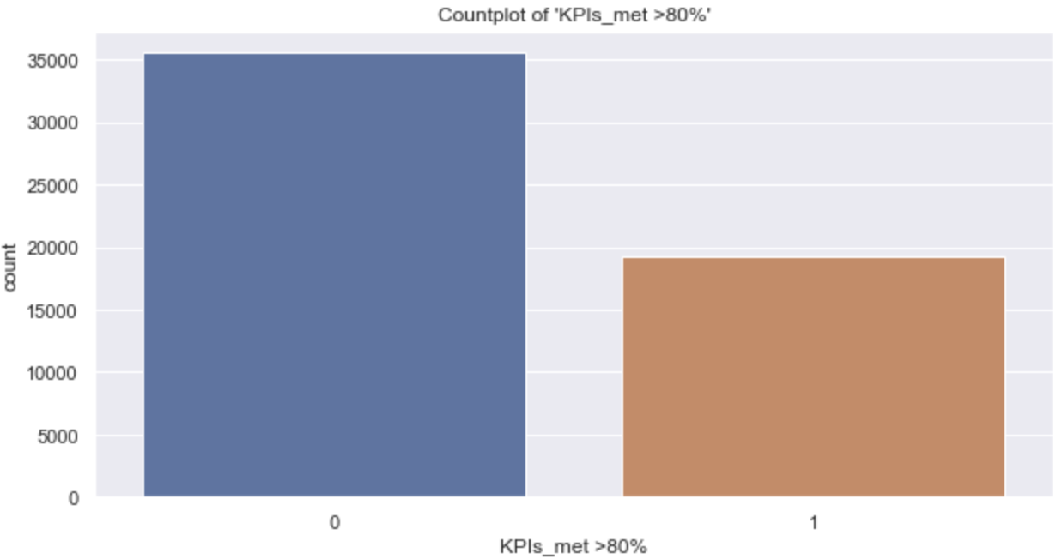
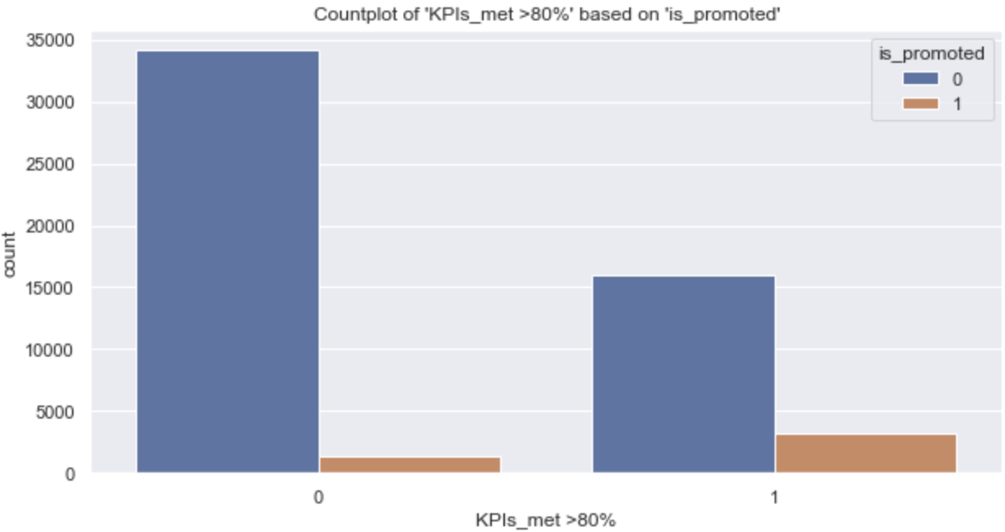
Data exploration:
The bar graph depicting the different types of ‘KPIs_met>80%’
Figures: Bar graph of types of ‘KPIs_met>80%’

Slide 26
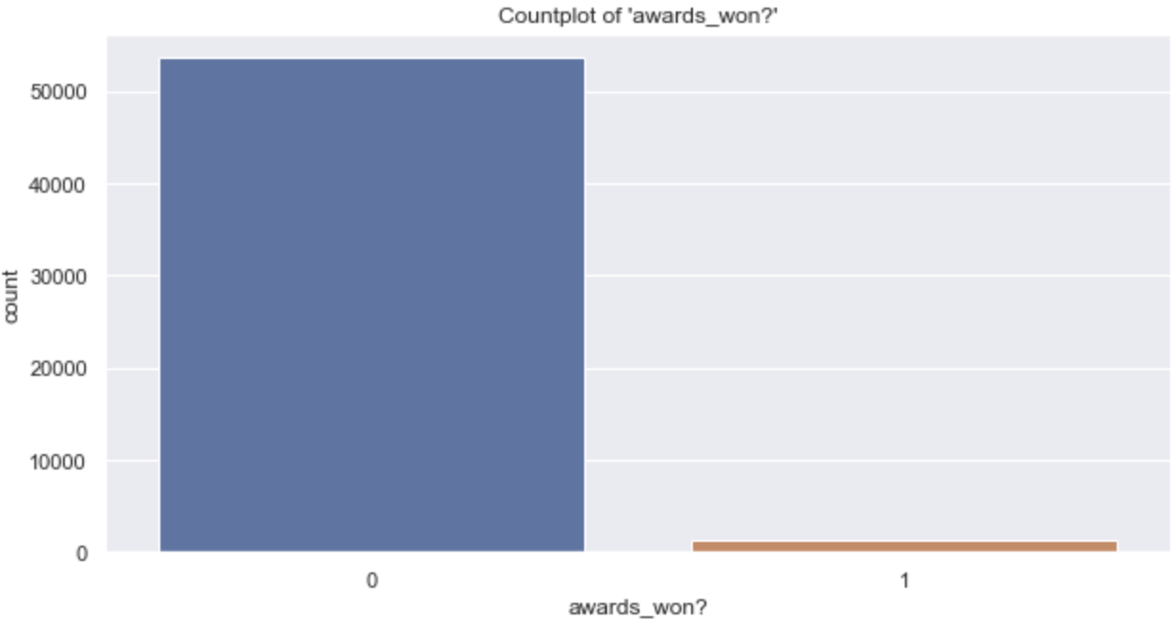
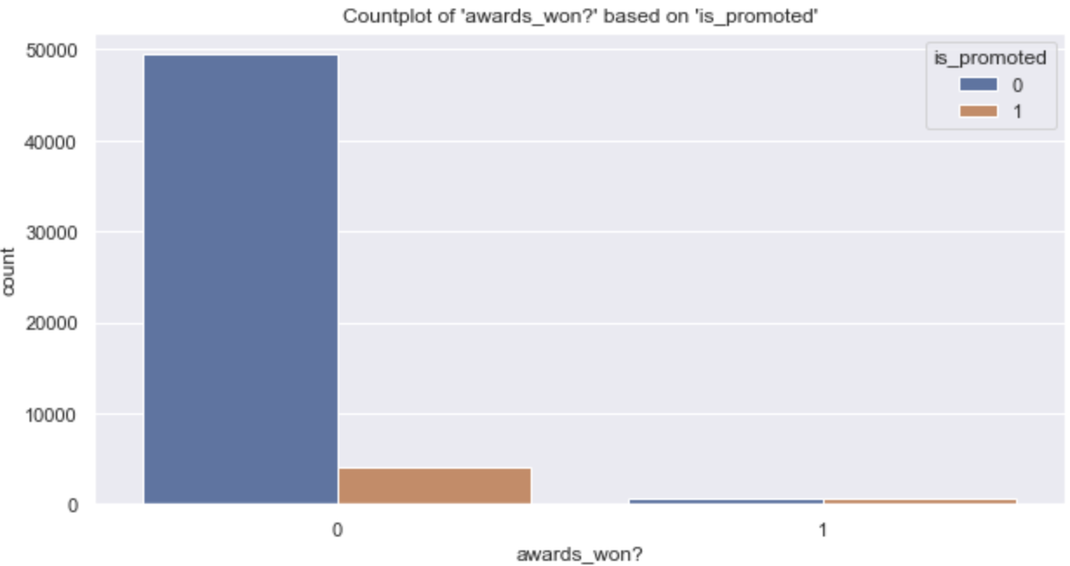
Data exploration:
The bar graph depicting the different types of ‘awards_won?’
Figures: Bar graph of types of ‘awards_won?’

Slide 27
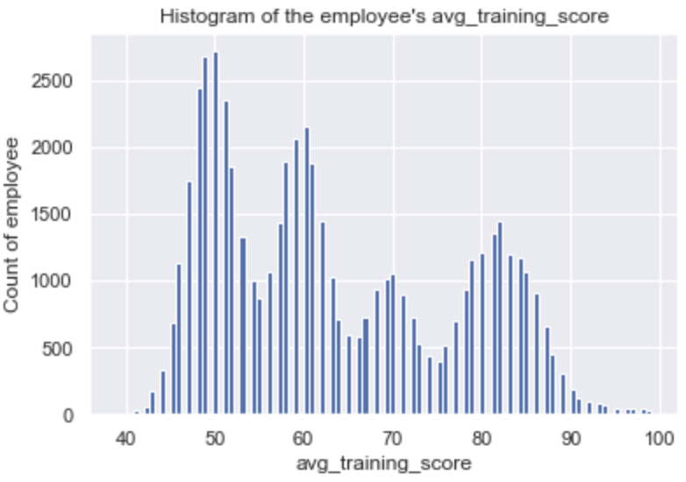
Data exploration:
The histogram depicting the distribution of the employee’s average training score
Figure: Histogram of the employee’s average training score

Slide 28
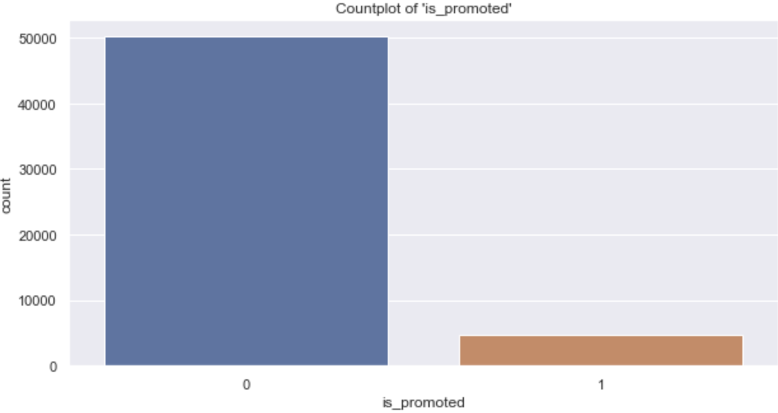
Data exploration:
The bar plot depicting the distribution of ‘is_promoted’(Target variable)
Key insights:
8.49% of the dataset contains 1 for ‘is_promoted’.
91.51% of the dataset contains 0 for ‘is_promoted’.
Figure: Count plot of ‘is_promoted’

Slide 29
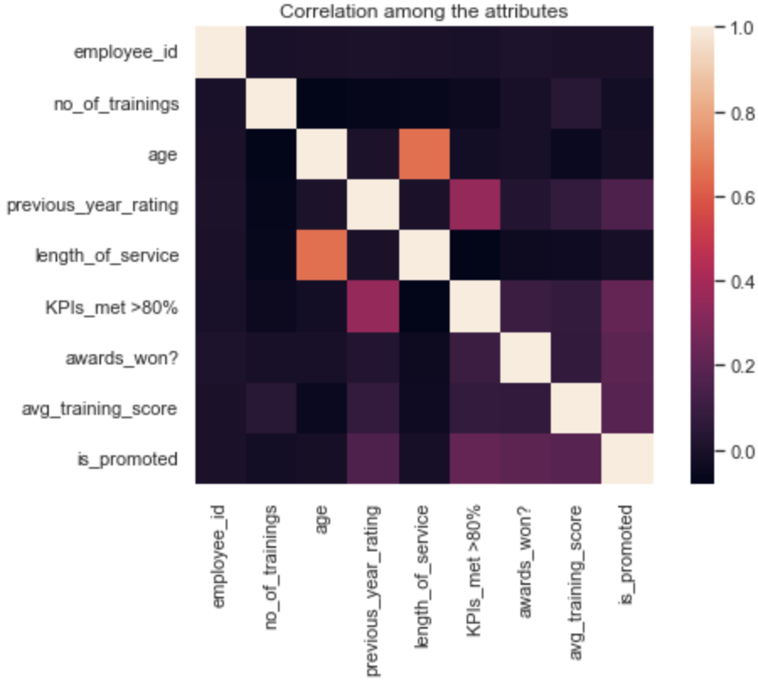
Data exploration:
The Correlation between different columns in the dataframe ‘employee’
Key insights:
‘employee_id’ has very less correlation with ‘is_promoted’
Thus it makes to drop it to prevent overfitting.
Figure: Heatmap of correlation between columns

Slide 30
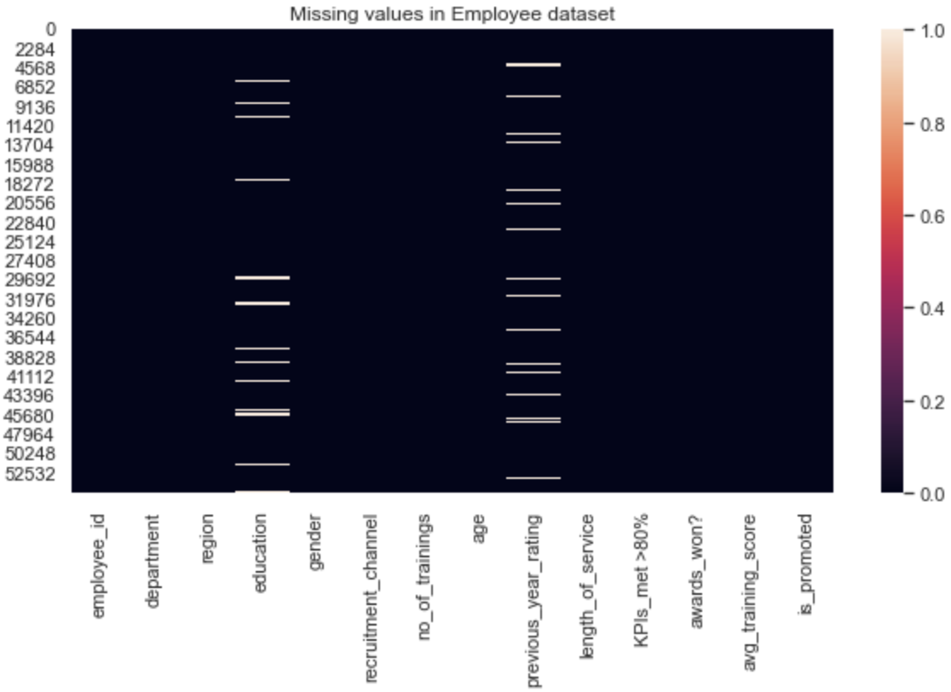
Missing Value Analysis:
The heat map of missing values of the dataframe ‘employee’
Figure: Percentage of missing values
Key insights:
‘education’ and ‘previous_year_rating’ have missing values.
Both are categorical variables.
Figure: heatmap of missing values

Slide 31

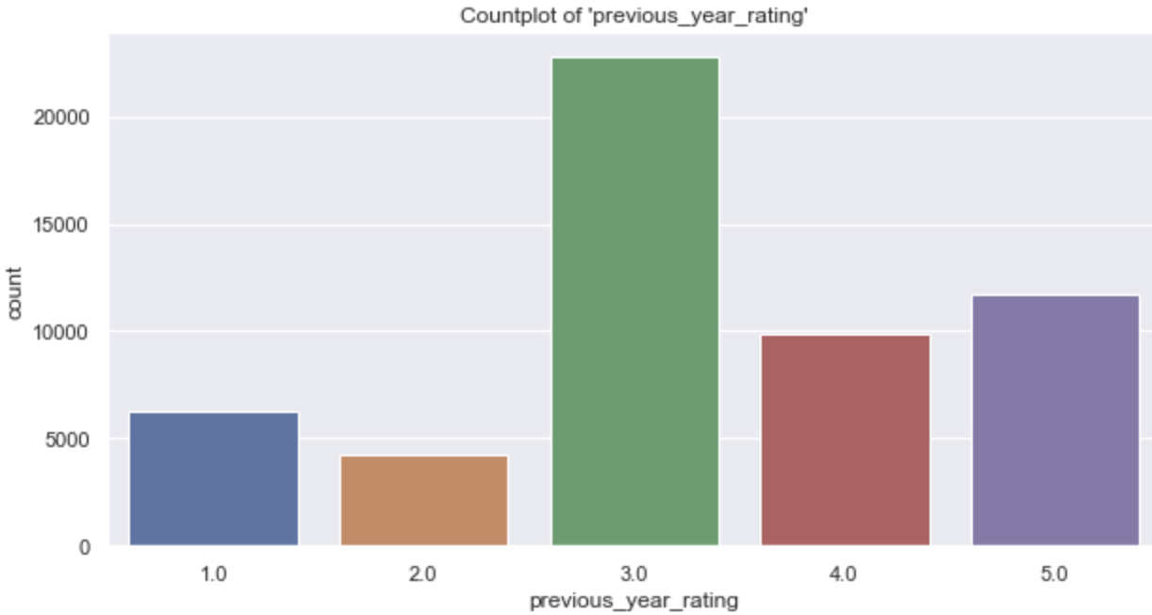
Missing Value Imputation for ‘previous_year_rating’:
Replacing all the nan values of ‘previous_year_rating’with the ‘mode’ of the distribution
Figure: Count plot of ‘previous_year_rating’ before imputation
Figure: Count plot of ‘previous_year_rating’ after imputation

Slide 32
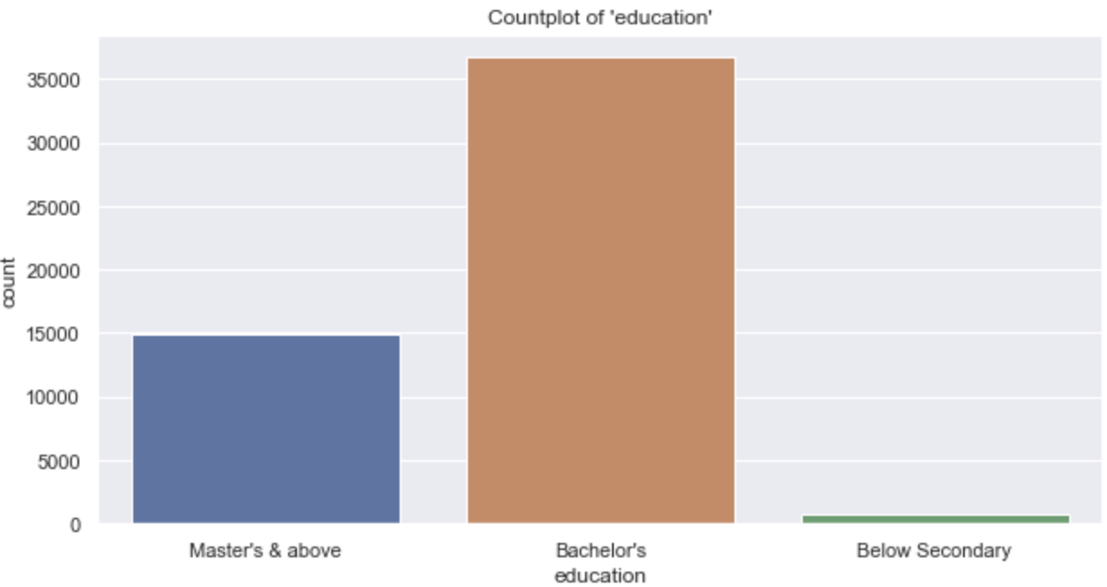
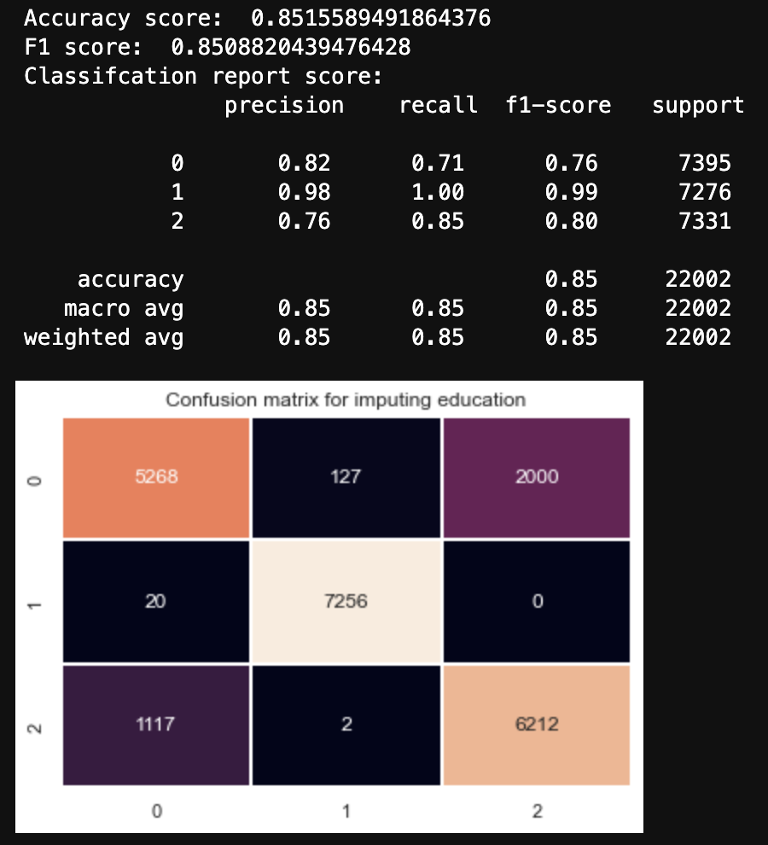
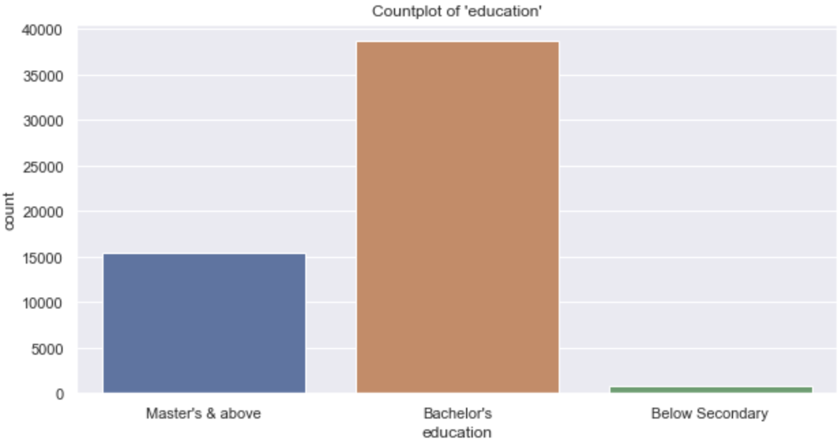
Missing Value Imputation for ‘education’:
Replacing all the nan values of ‘education’ by using a RandomForest classification model
Figure(right): Countplot of ‘education’ before and after imputation.
Figure(top): Performance of the RandomForest model

Slide 33
Dealing with Unbalanced target variable:
Unbalanced datasets decrease the ‘f1_score’.
Figure: Dataset size without using SMOTE and using SMOTE
Key insights:
8.49% of the dataset is 1 rest 0.
SMOTE algorithm to be used for undersampling/oversampling
Figure: Count plot of ‘is_promoted’

Slide 34
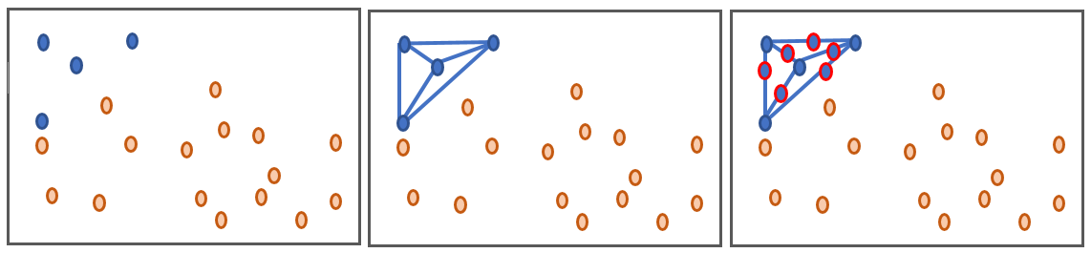
Dealing with Unbalanced Dataset/SMOTE:
SMOTE: Synthetic Minority Over-sampling Technique
Figure: Working of SMOTE algorithm

Slide 35
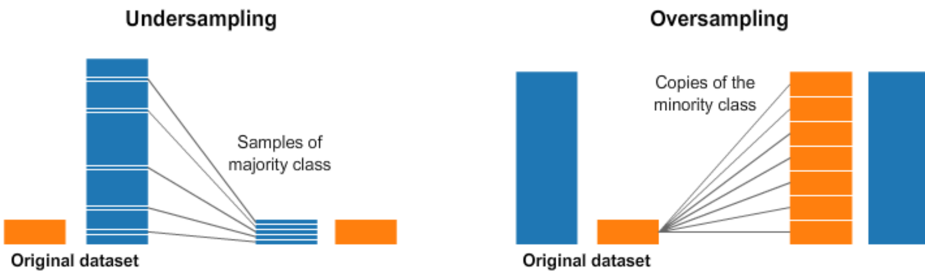
Dealing with Unbalanced Dataset/SMOTE:
SMOTE: Undersampling vs Oversampling
Figure: Working of SMOTE algorithm (Undersampling vs Oversampling)

Slide 36
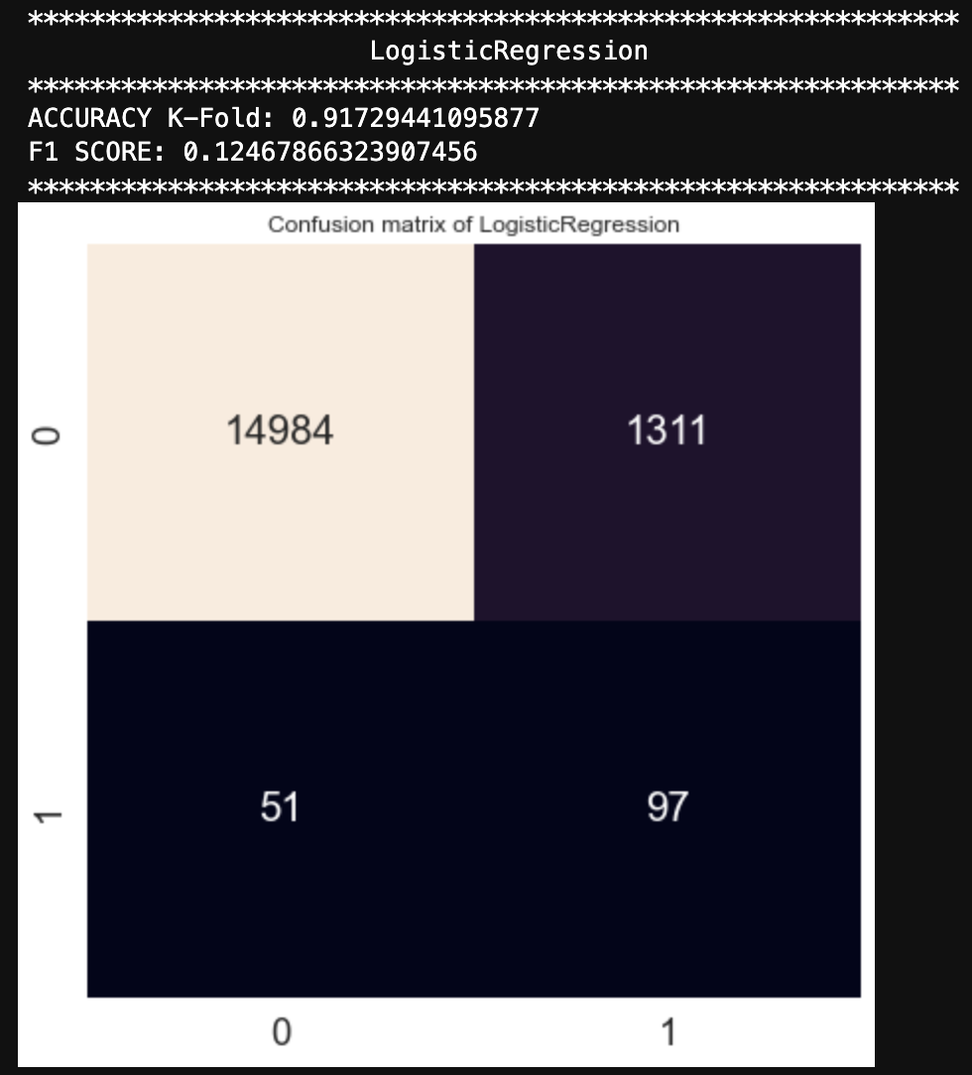
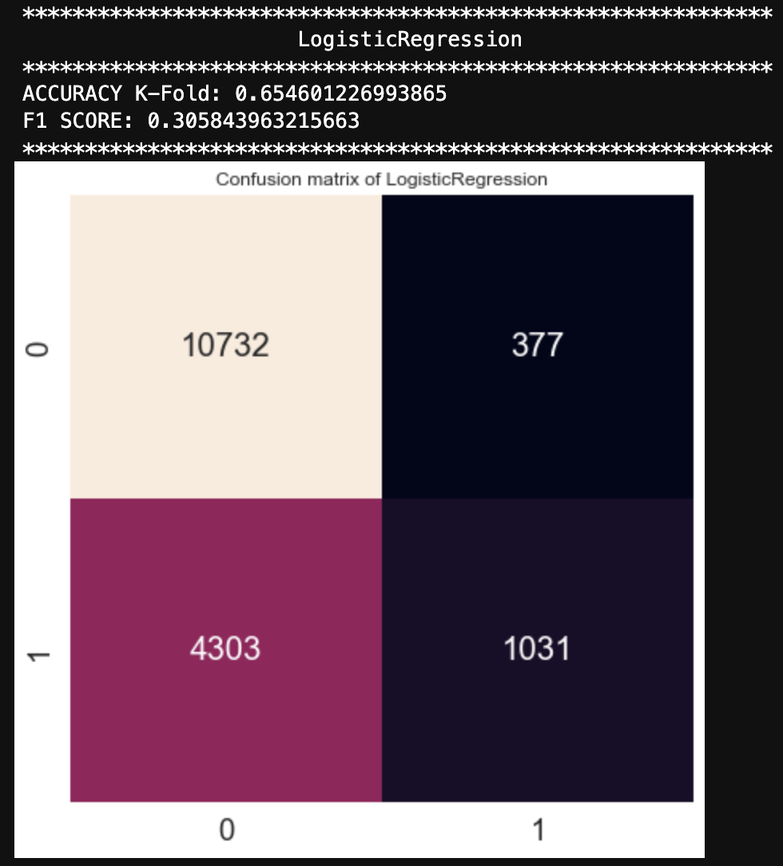

Modelling and Model testing:
We fitted a Logistic Regression model.
Figure: Comparison between without SMOTE(left), and with undersampling (middle) and oversampling(right).

Slide 37
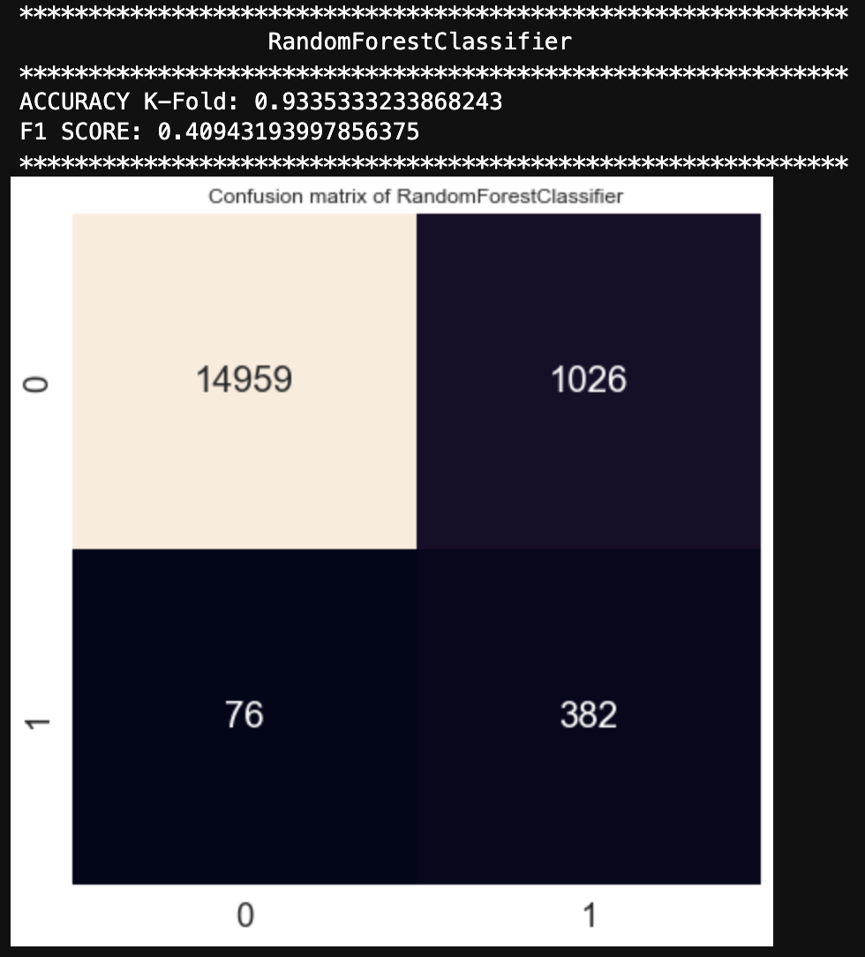
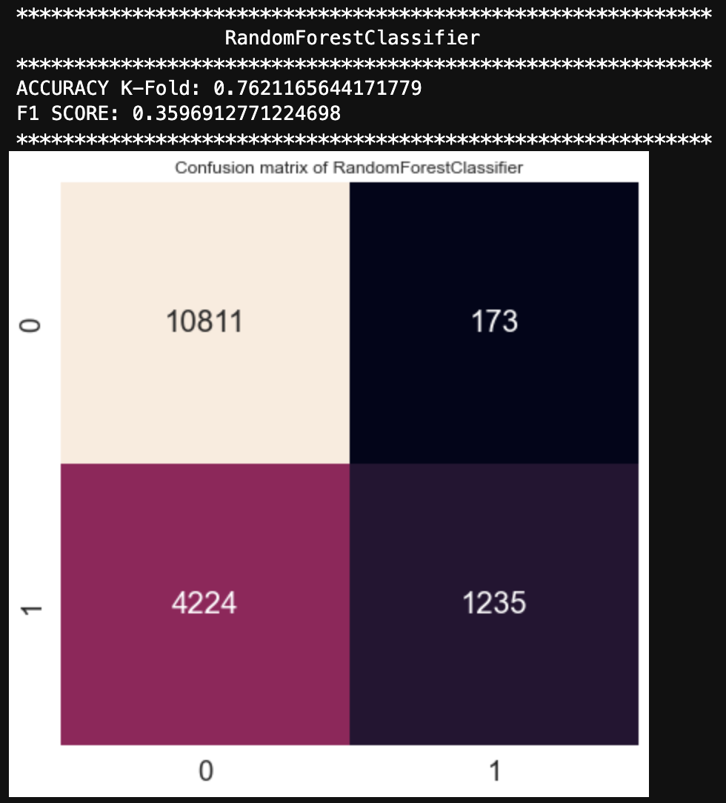
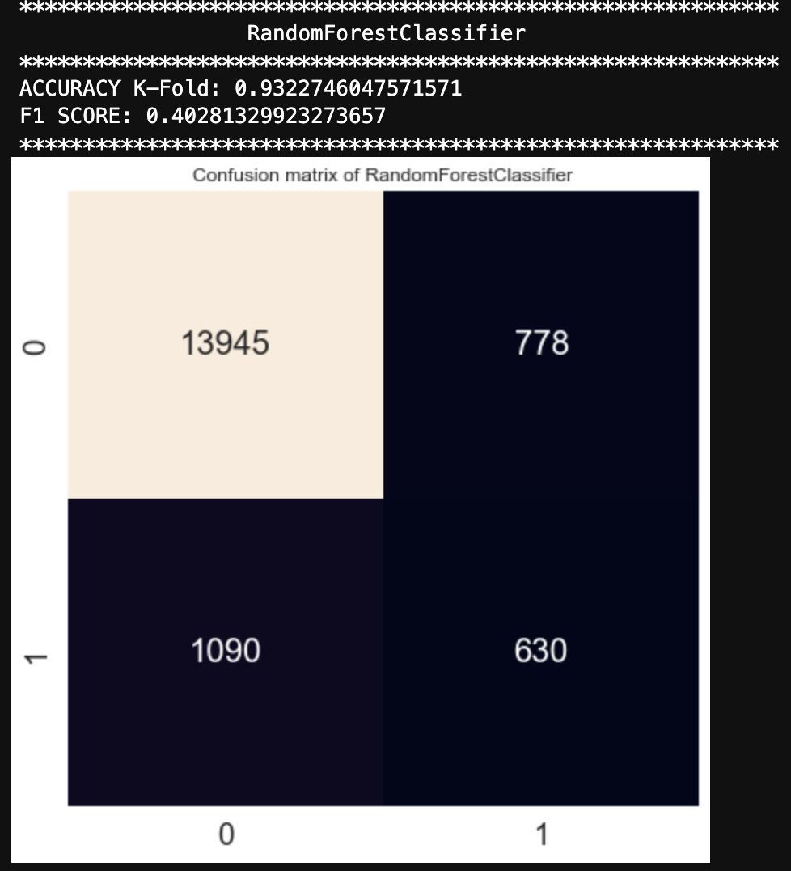
Modelling and Model testing:
We fitted a Random Forest model.
Figure: Comparison between without SMOTE(left), and with undersampling (middle) and oversampling(right).

Slide 38

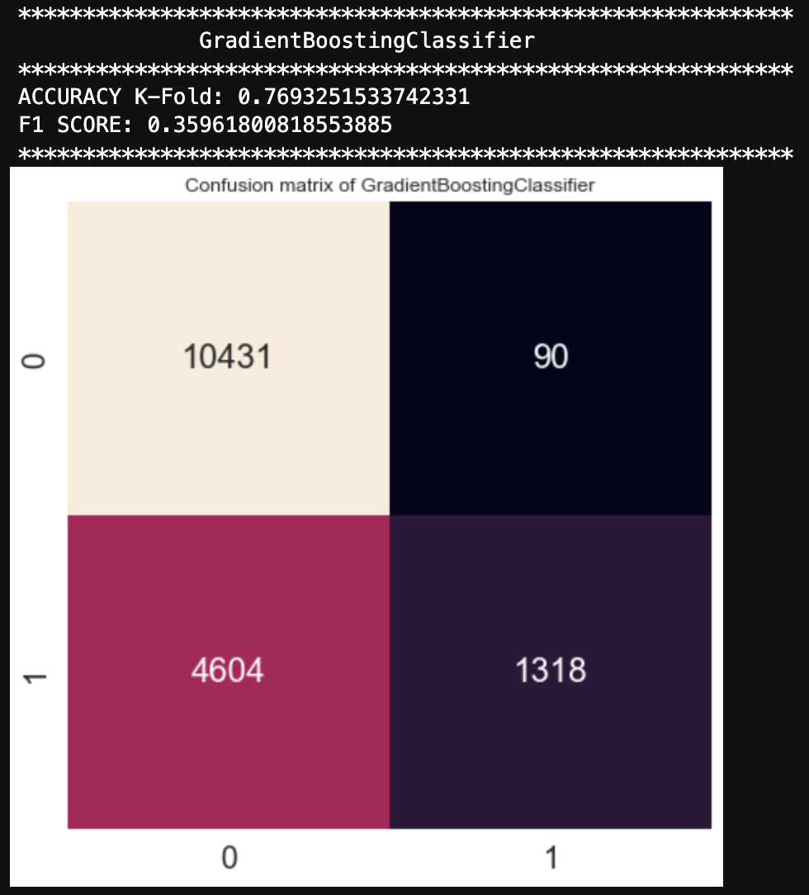
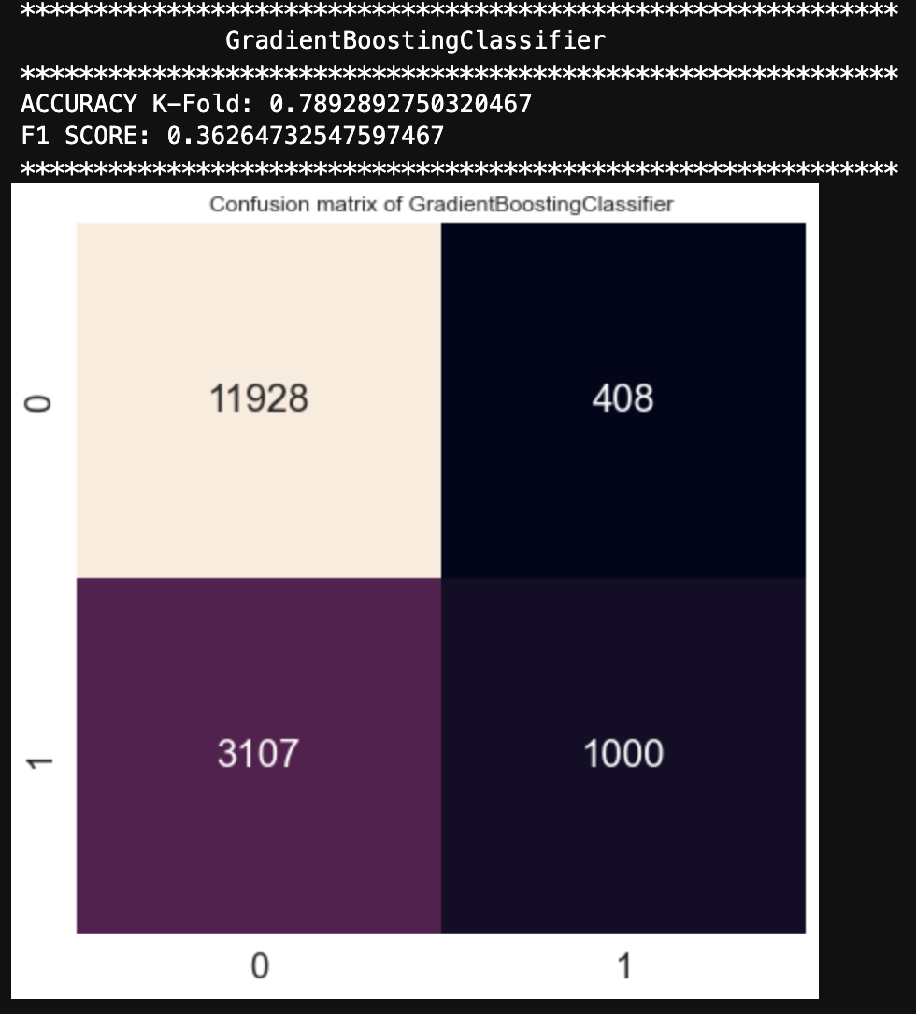
Modelling and Model testing:
We fitted a Gradient Boosting model.
Figure: Comparison between without SMOTE(left), and with undersampling (middle) and oversampling(right).

Slide 39
Improvements?

Slide 40
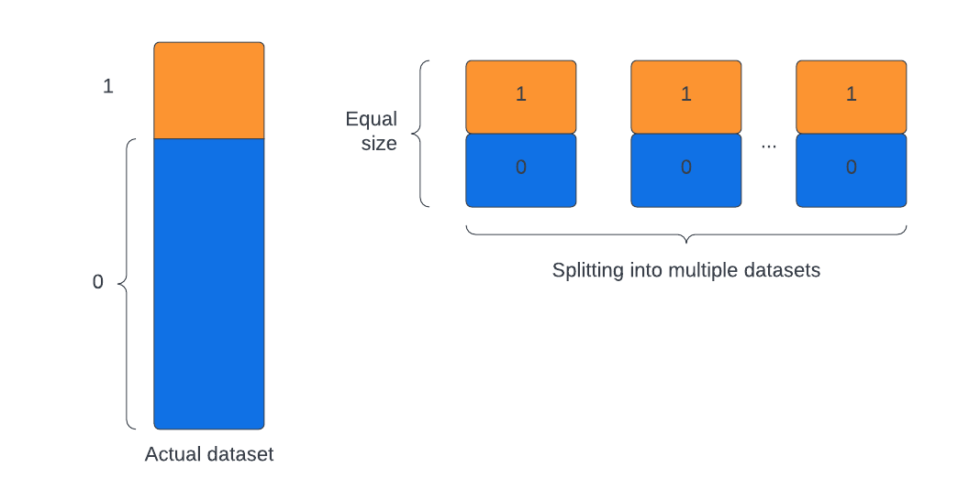
Creating multiple datasets by combining Undersampling and Oversampling techniques:
Approach:
Use Undersampling technique to create multiple smaller datasets.
Use Oversampling technique to make the dataset balanced.
Run different machine learning models and make predictions based on some voting metric.
Figure: New Dataset structure

Slide 41
Conclusions
We performed missing data imputation.
We tried to synthetically generate new data points to deal with unbalanced dataset.
Gradient Boosting outperforms other models in terms of accuracy and F1 score.

